Slide 1

Automated Solar Tracking system
By C.M Mashele, N Shakudyiwa, S Nhlebela, J Gunduane, L Machaba
Group 7
Module : Embedded Systems 316 (EMS316D)

Slide 2
Objective:
To design a solar tracking system that automatically follows the sun using a single-axis rotation for improved solar energy capture.
Key Features:
Arduino Uno based control
Light-dependent resistors (LDRs) for sun detection
Servo motor for panel movement
Solar panel to capture sunlight

Slide 3
How It Works
Two LDR sensors measure light intensity on both sides of the panel.
Arduino compares LDR readings.
If one side gets more sunlight, the servo rotates the panel toward it.
This keeps the panel facing the sun for maximum energy capture.

Slide 4
Components Used
Arduino Uno
Servo Motor
2x LDR sensors
Resistors (10kΩ)
Breadboard and jumper wires
5V Solar Panel

Slide 5
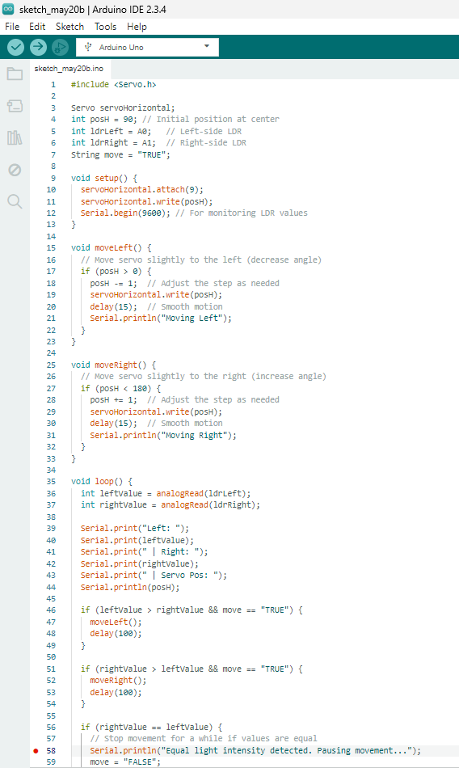
Code Explanation
Main Logic:
Read LDR values from analog pins.
Compare LDR readings.
If difference > threshold, rotate servo.
Delay to avoid constant movement.
Bonus:
Use Serial Monitor to display sensor values.

Slide 6
Energy Efficiency Logic (Planned Feature)
A Feature That Allows The Solar Panel To Not Only Track The Sun But Also Charge A Battery.
How It Would Work:
Solar panel powers a battery charging circuit.
Battery level can be shown using LED indicators or Serial Monitor.
How It Would Work:
- Solar panel powers a battery charging circuit.
- Battery level can be shown using LED indicators or Serial Monitor.
Why It's Useful:
Demonstrates energy being stored (not just used)
Makes the system usable even when sunlight is gone
Makes the project more sustainable

